Slide 1

Predict Age, Gender and Ethnicity
Debsankar Mukhopadhyay
Vasim Shaikh
William Yerkes
Prabhanjan Trivedi
CS5542 – Big Data Analytics and Application - Project Presentation

Slide 2

Content
Introduction & related works – Debsankar M
Methodology – Vasim S
Experimental Results and Discussion – William Y
Conclusion – Prabhanjan T
Q & A
Journal Paper link - https://doi.org/10.1186/s40537-020-00358-x

Slide 3
Introduction
Provide the ability for companies to utilize their CCTV to capture images of their clients so as to be able to determine the demographics of their clientele so as to customize their marketing strategies to be able to be able to maximize the capital investment in targeted advertisement.
Utilize Artificial Neural Networks, (Convolutional Neural Network for this model) to analyze the images and determine the age, gender and ethnicity of the clientele
Create a single model that can determine all Three of the categories

Slide 4
Background and Related Works
The structure of a CNN architecture is divided into multiple learning stages composed of convolutional layers, non-linear processing units, and subsampling layers
tbd
tbd

Slide 5
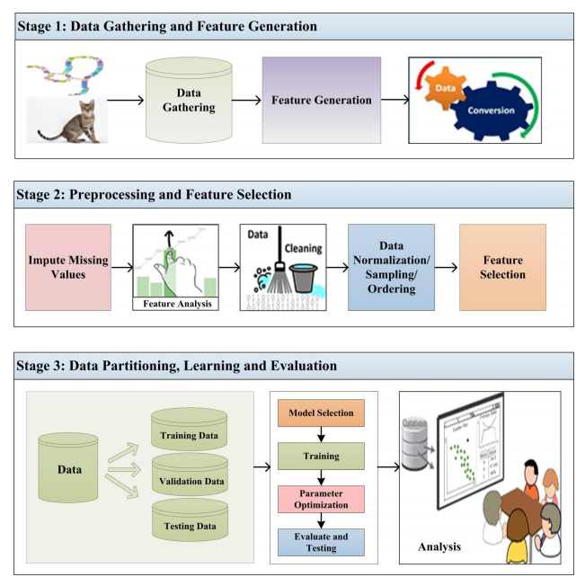
Background and Related Works

Slide 6
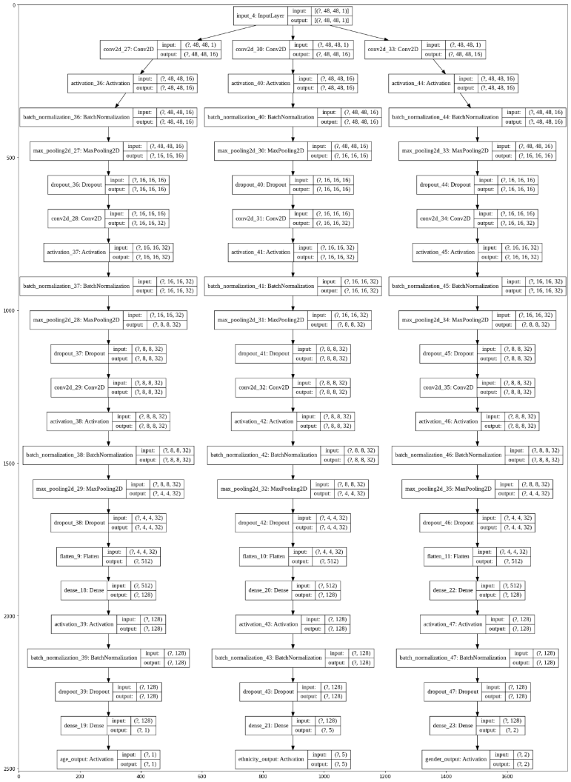
Architecture and Methodology

Slide 7
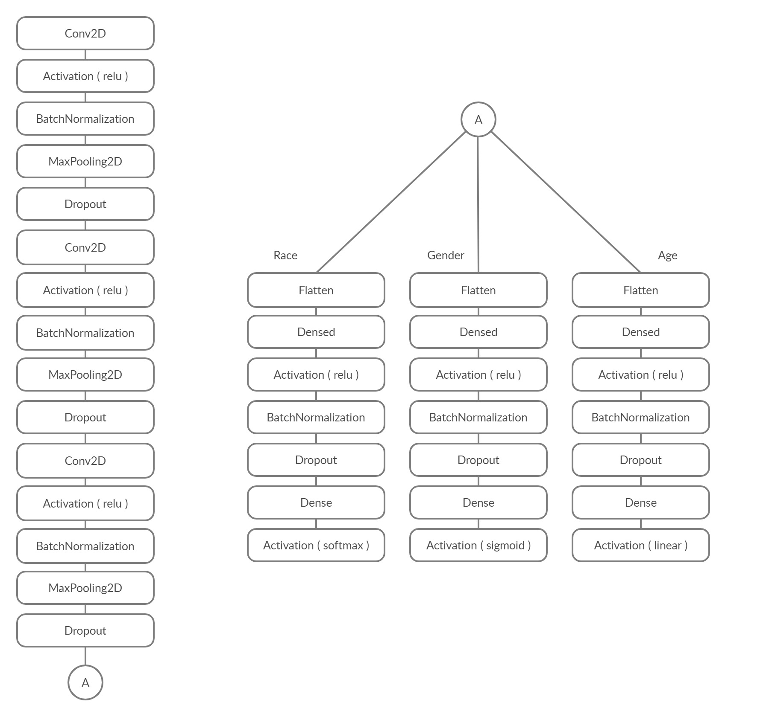
Unified Model

Slide 8
Data
23705 Facial Images
Image Size is 48 x 48 pixels
Classifications
Data is classified bases on three parameters:
Age, Ethnicity and Gender
Age has a range of 0 to 116
Ethnicity is broken down into 5 categories
Gender is classified as Male or Female

Slide 9
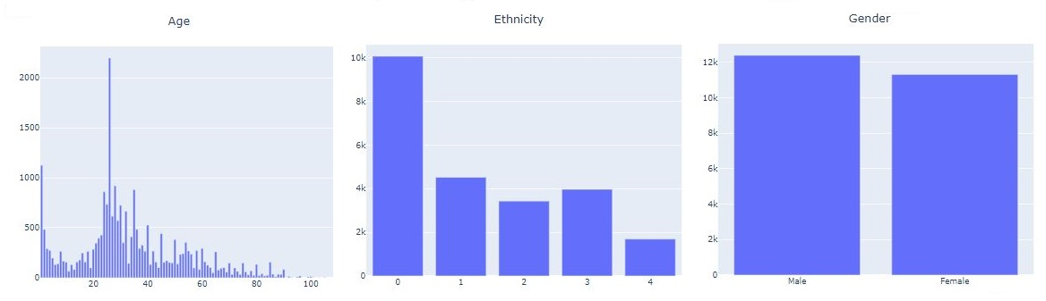
Data Distribution

Slide 10
Results
Model Prediction Accuracy:
Race Accuracy of 76%
Category 0 ……………..82%
Category 1 ……………..81%
Category 2 ……………..78%
Category 3 ……………..69%
Category 4 ……………..11%
Gender Accuracy of 89%
Male ……………………...89 %
Female …………………..88 %
Stats for Age Model

Slide 11
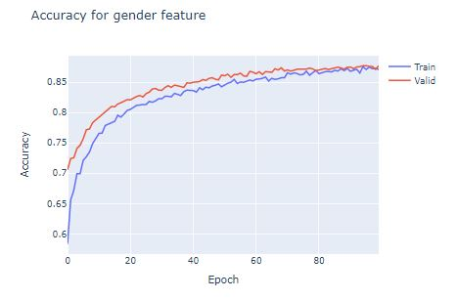
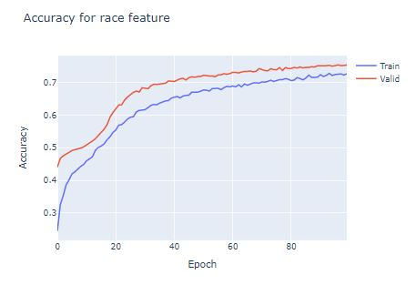
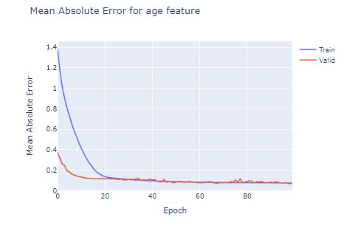
Results

Slide 12
Discussions

Slide 13
Conclusions

Slide 14
Future Outlook

Slide 15
Q & A

Slide 16
THANK YOU

